Slide 1
ViEW: VCS in Excel, Word
Abhijit Roy
VFD

Slide 2
Content
Session-1
Why?
How?
Demo 1 (Short)
Installation
Define Terms
Data Storage
Demo 2 (repo, init, clone, push, fetch, pull)
Session-2
Define Terms (Branch, Merge)
Demo 3 (Advanced -> branch, merge, …)
Case Study (implement in Dry Etch)

Slide 3
SESSION-1

Slide 4
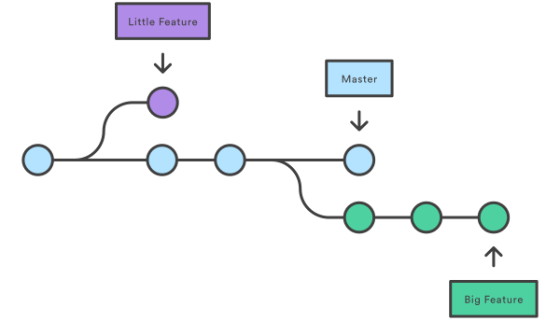
Why?
Data logs
Collaboration Tool
Authentication
Anonymous
Sync
Data Storage

Slide 5
How?
Production Logbook
QC Logbook
Spares Record
Indent
OP Documents

Slide 6
Demo-1 (Short)
Show a file @ datetime
Compare b/w a file @ datetime-1 and latest
Compare b/w a file @ datetime-1 and datetime-2

Slide 7
Installation
MS Office 2013 Professional Plus (PAID)
Bonobo Git Sever (FREE) – For managing users and control project directory (Repo)
Fork Git Client (FREE) – to visualize a Git Folder.
Git for Windows (FREE) – support for execution in Terminal
Batch files (showc, diffc1, diffc2) - created for Excel, Word files. (Developed)
Set Environment Paths

Slide 8
Data Storage
Server – a folder in e.g. \\vmfg\sections\Dry Etch\Server network
Client – a folder in e.g. \\vmfg\sections\Dry Etch\Client network

Slide 9
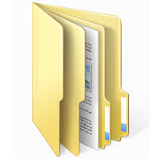
Define Terms
Repository (or Repo): means all of the files, folders in a project directory

Slide 10
Define Terms
Remotes/origin/master: means “Main” branch in a server directory (repository)

Slide 11
Define Terms
Branches/master: like “Main” branch in a client directory (repository)
Branches/new-feature: means “new-feature” branch in a client directory (repository)

Slide 12
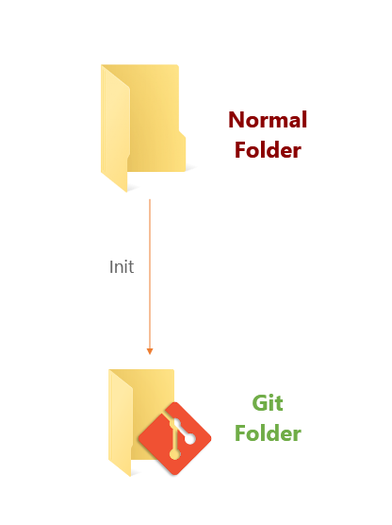
Define Terms
Init – like initializing a folder with Git protocol. Basically, a .git folder created inside.

Slide 13
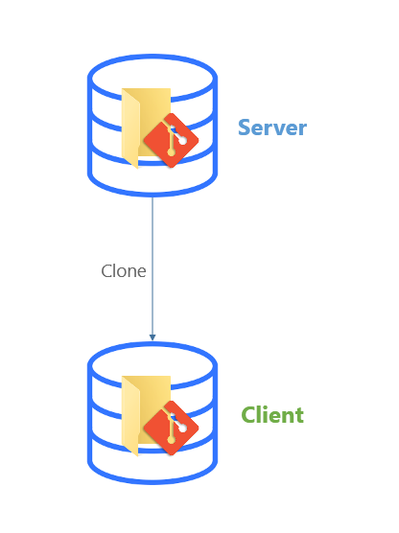
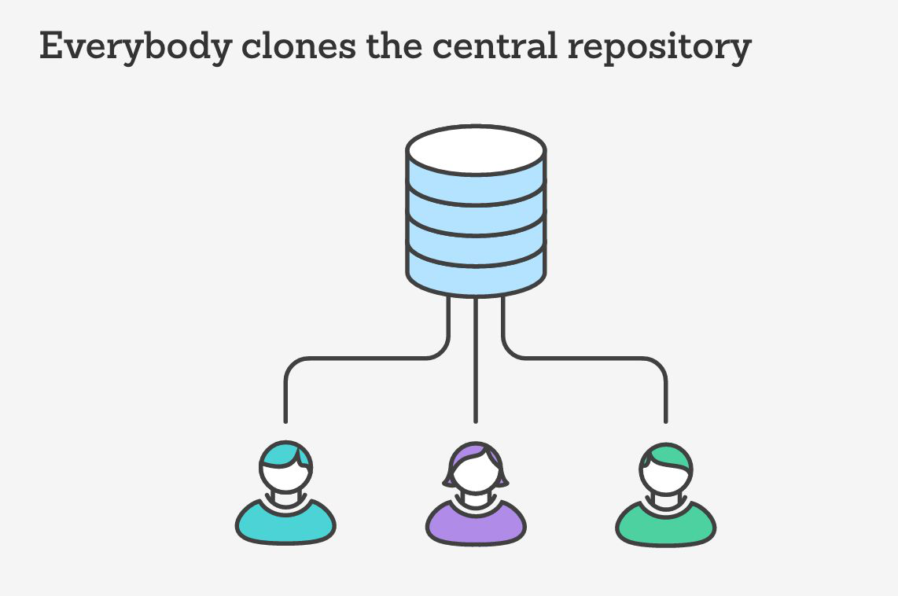
Define Terms
Clone – like download a project directory (repository).

Slide 14
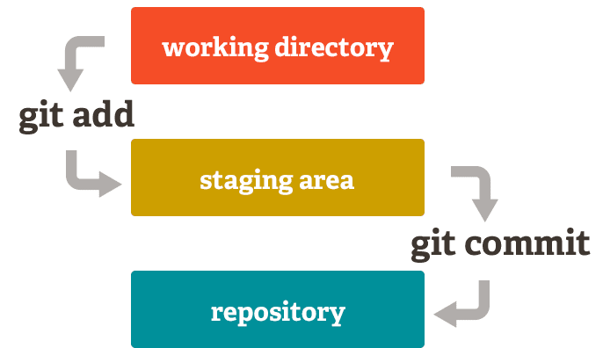
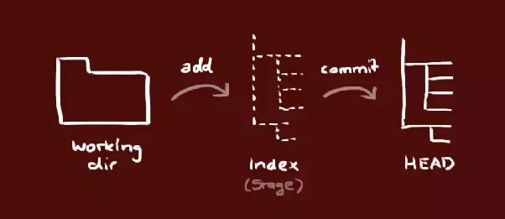
Define Terms
Stage – like add/register files for recording changes (in repository).

Slide 15
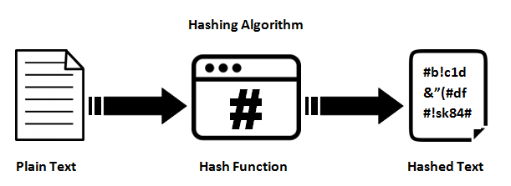

Define Terms
Commit – like save/record changes (in repository).

Slide 16
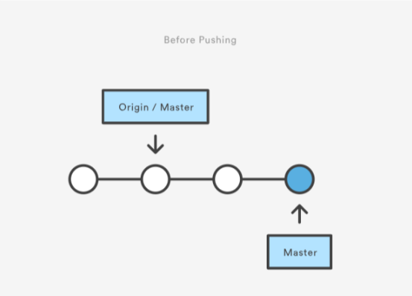
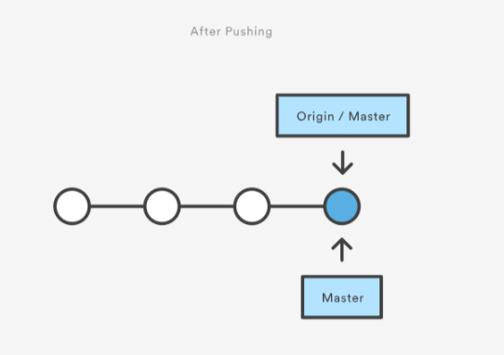
Define Terms
Push – like upload file changes (repository).

Slide 17
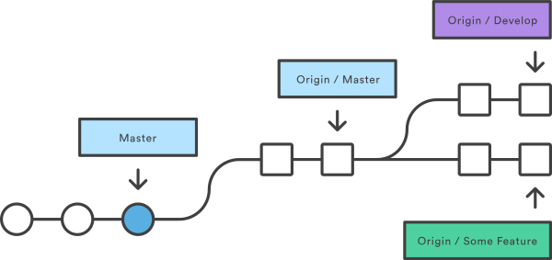
Define Terms
Fetch – like downloading changes from remote directory (repository).
NOTE: The changes in local repo is not applied to the remote repo.

Slide 18
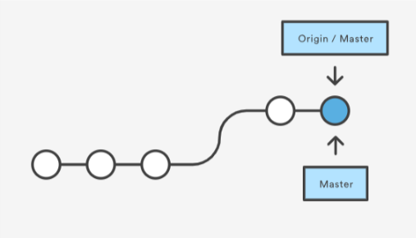
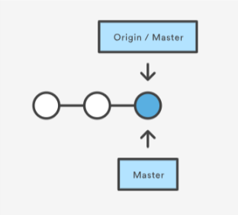
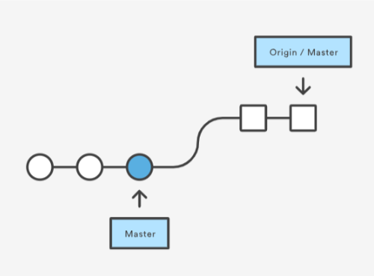
Define Terms
Pull (= Fetch + Merge) – like downloading changes & merges (in repository).
Sync remote repo with local repo.
Notes:
https://support.office.com/en-ie/article/always-show-the-pointer-during-a-presentation-ac582334-2c8f-4000-a52e-1c6a055ba620

Slide 19
Demo-2
Repository
Master
Init
Clone
Stage
Commit
Push
Fetch
Pull

Slide 20


